Slide 1

Approaches of Artificial Intelligence
Prepared By
Deepa Kumari Paneru
Roll No:11

Slide 2
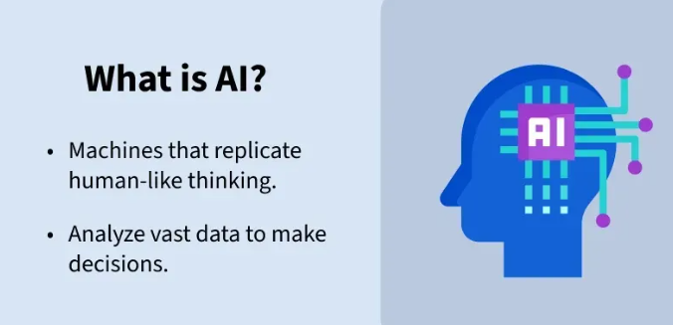
Introduction to AI
AI stands for Artificial Intelligence ,is the
capability of computer systems to behaves
as human like thinking,learning,reasoning,
problem solving ,decision making etc.

Slide 3
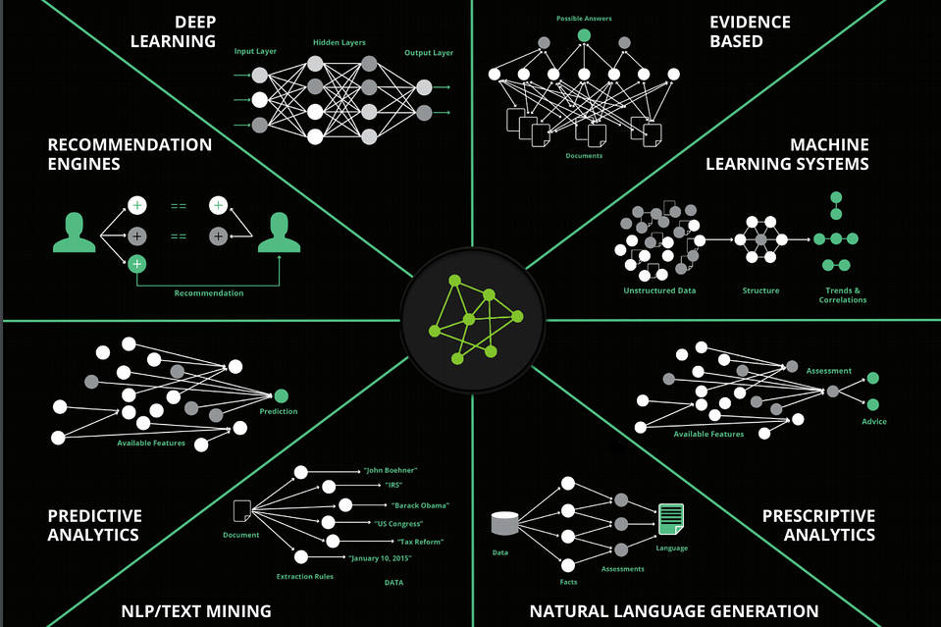
Approaches Of AI
AI Approaches is defined as the different philosophical or technical methodologies used to design and build artificial intelligence systems.The approaches define both the ultimate goals and specific techniques to achieve the goals.
This Photo by Unknown Author is licensed under CC BY-NC

Slide 4
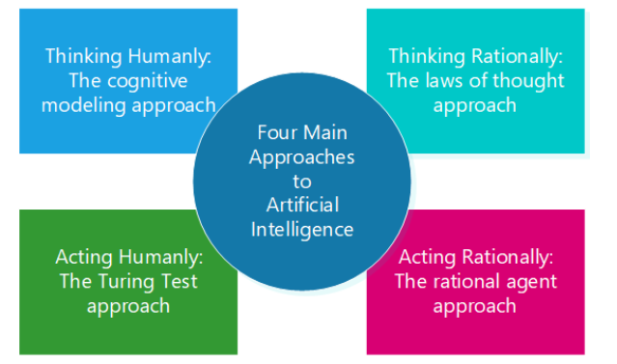
Types of AI Approaches

Slide 5

1.Thinking Humanly
Focuses on creating systems that mimic human thoughts process through cognitive modelling.
Uses the techniques like artificial neural network to model how the brain processes information.
Examples:Boeing,General Problem Solver etc.

Slide 6

2.Acting Humanly
Creating systems that can perform tasks like a human.
Examples: Tuirng test,Chatbots and Virtual Assistant like ChatGPT,siri,google assistant.

Slide 7

3.Thinking Rationally
Uses the ‘law of thought’ to ensure systems reason logically and correctly. This approach focuses on making sound, logical conclusions based on symbolic logic.
Examples:Expert Systems,Logic Programming language.

Slide 8

4.Acting Rationally
Focuses on creating rational agents that act achieve the best possible outcomes or highest value for a task.
Most modern AI systems like Autonomous Vehicles , sensors (cameras, LiDAR, GPS),robotics etc fall under this category.

Slide 9

Conclusion
AI is the hybrid field of thinking humanly,acting humanly,thinking rationally and acting rationally. AI approaches reflects a continuous pursuit of building machines that can solve complex problems.

